Slide 1
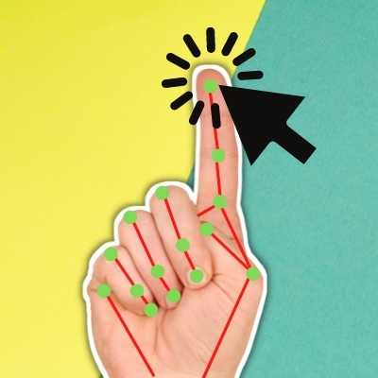
Introduction
There is no other more popular navigation/interaction device than the mouse.
Overcoming the restrictions a corporeal device has would enrich the experience of interaction.
Keeping this in mind, we present an idea of implementing a virtual mouse system as an alternative.

Slide 2
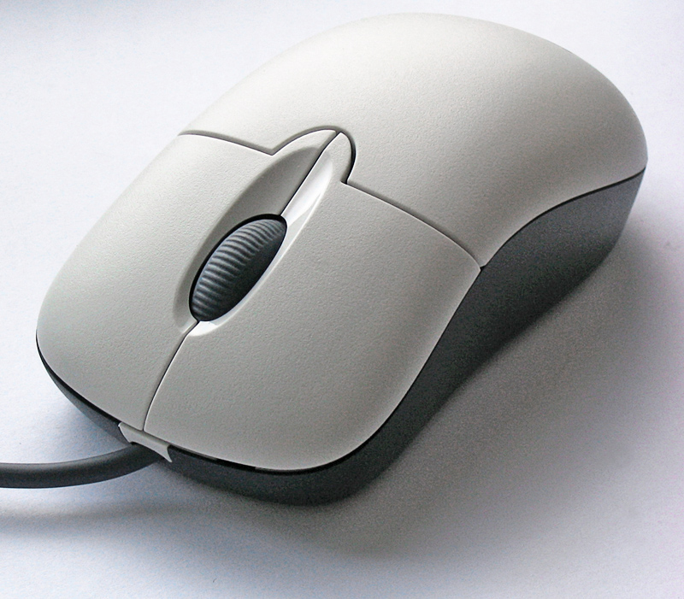
Abstract
The mouse is one of the wonderful inventions of Human-Computer Interaction (HCI) technology
Currently, wireless mouse or a Bluetooth mouse still uses devices and is not free of devices completely since it uses a battery for power and a dongle to connect it to the PC.

Slide 3
Objective
The main objective of the AI virtual mouse system is to control the mouse cursor functions by using the hand gestures instead of using a physical mouse
The goal is to manage computers and other devices with gestures rather

Slide 4
Hardware And Software Required
Hardware Requirements -
Intel Pentium D processor 1.8 GHz or AMD Athlon X2 processor 1.8 GHz or higher
3 GB RAM
5 GB HDD space
Peripheral webcam at least 30 frames/second, 640x480 resolution
Software Requirements -
Windows XP x86 or higher (for x86 environment)
Windows XP professional x64 or higher (for x64 environment)
.NET framework 3.5 or higher
Visual Studio 2008 professional
EmguCV library (wrapper of OpenCV library for .NET framework
EmguCV library 64 bit binaries (for developing on x64 environment)
Webcam drivers (device specific)

Slide 5
Proposed System
Any new products should either make human life more confortable, more productive or more fun.
Provides grather flexibility than the existing system.
Can provide more functions depending on the choice of object.
Easy to modify and adapt
Less prone to physical damage due to absence of a fixed Physical device.
Avoid the mouse-related wrist damage like CTS & RSI.
Also, there is a certain degree of fun & entertainment associated with the whole idea.

Slide 6
Flow Chat
Image
Acquisition
Object
Recognition
Track Object
Event
Generation
Setting Cursor
Position
Coordinate
Calculation

Slide 7
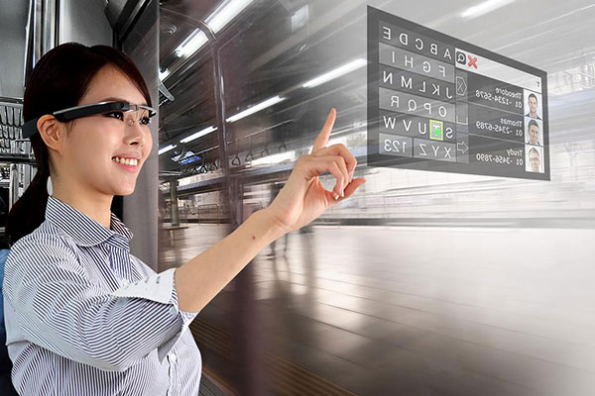
Feature Enhancement :
Development for specific objects.
Creation of particular action areas for utility.
More advanced and highly specific functionality.

Slide 8
Conclusion
Virtual Mouse is an idea of implementing an adaptable, multi- functional navigation/interaction tool that overcomes physical barriers.

Slide 9
References
Artificial Intelligence – A Modern Approach (3rd Edition) – By Stuart Russell & Peter Norvig
Machine Learning for Dummies – By John Paul Mueller and Luca Massaron
Machine Learning: The New AI – By Ethem Alpaydin
The Hundred-Page Machine Learning Book – By Andriy Burkov
Artificial Intelligence for Humans – By Jeff Heaton
Building Virtual Machine Labs A Hands-On Guide - Mr. Tony V Robinson
Oracle VirtualBox Administration A beginners guide to virtualization! - Arun Kumar

